Slide 1



Entering Pages to Possibilities Volunteer Time in Learning Genie

Slide 2

Adding Pages to Possibilities Volunteer Time
Determine which Volunteer Category Applies
Entry Options | Community Volunteer | Parent (child’s class) | Parent (child not in the class)
1. Staff Entry | Teacher/Staff LG app | Teacher/Staff LG app | Teacher/Staff LG app
2. Parent Entry | N/A | Parent LG app youtube.com/watch?v=LYGIurYJ-Us&feature=youtu.be | Best for teacher/staff to enter for recording to correct class
3. Via URL | Send URL | N/A | N/A
Preferred Method
Option

Slide 3
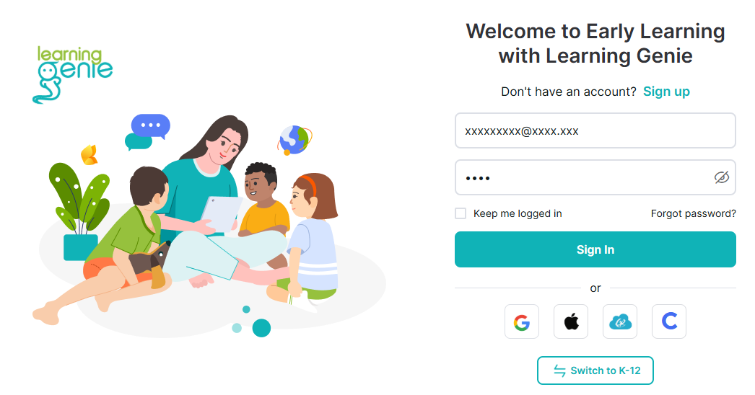
Adding Pages to Possibilities Volunteer Time
Open Learning Genie
Log in

Slide 4
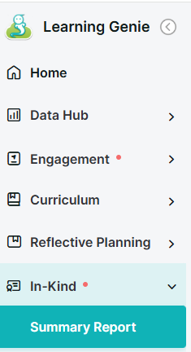
Adding Pages to Possibilities Volunteer Time
From the menu on the left, select:
In-kind
Summary Report
1
2
Community Coordinated Care for Children, Inc. (4C)

Slide 5
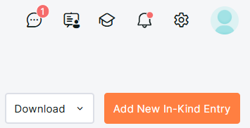
Adding Pages to Possibilities Volunteer Time
From the top right, select:
Add New In-kind Entry
Note: This is the same starting place as when you enter parent activities.
3

Slide 6
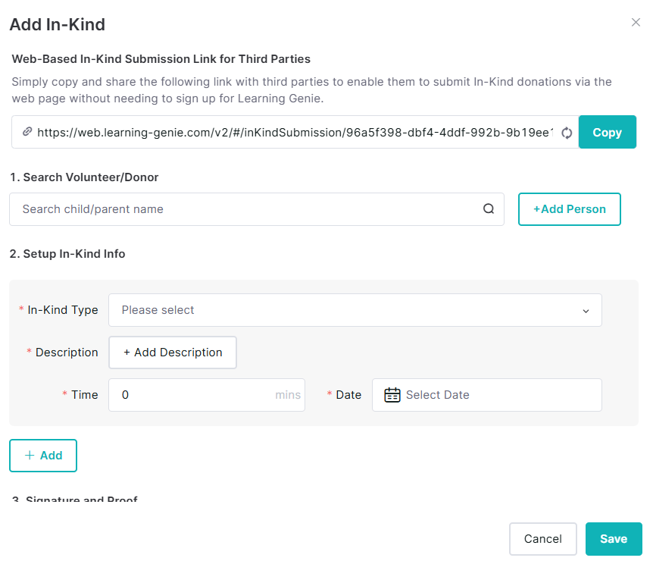
Adding Pages to Possibilities Volunteer Time
This form will open:
Select:
  Add Person if they are a community volunteer (non-parent) or
  Search name if a parent (all parents with a child actively enrolled are searchable).
4
b
a

Slide 7
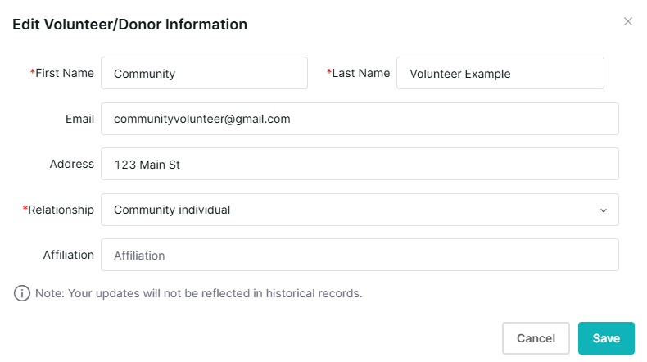
Adding Pages to Possibilities Volunteer Time
Add the Volunteer Information Step 4a:
Add the volunteer’s first and last name.
Use the pull down to add Relationship
  If community Entity is selected, add the affiliation.
Note: these are the only required fields, but add other information, if known.
5
6
6a

Slide 8
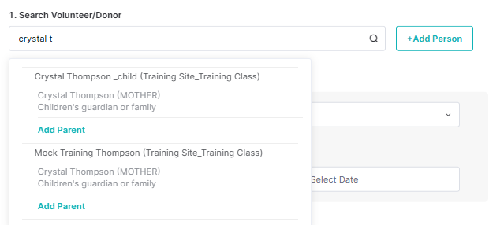
Adding Pages to Possibilities Volunteer Time
4b. Select the searched parent and appropriate class

Slide 9
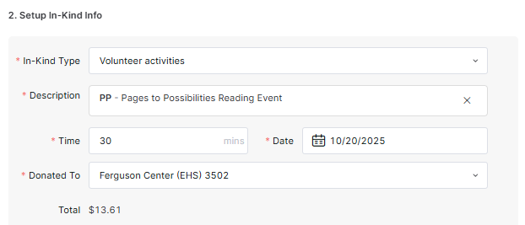
Adding Pages to Possibilities Volunteer Time
Complete rest of form:
In-Kind Type, select Volunteer Activities
Description – select code PP from the list
Time – enter the minutes volunteered
Enter the date volunteered
Enter the Site
7
8
9
10
11

Slide 10
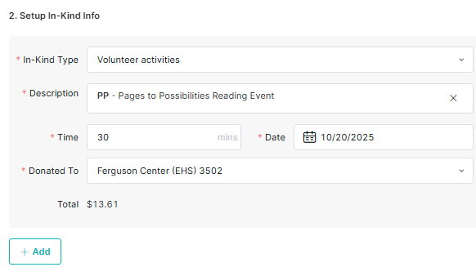
Adding Pages to Possibilities Volunteer Time
12. If you have more entries for the same volunteer for different dates, select add and repeat steps 7-11.
Repeat
7
8
9
10
11
12

Slide 11
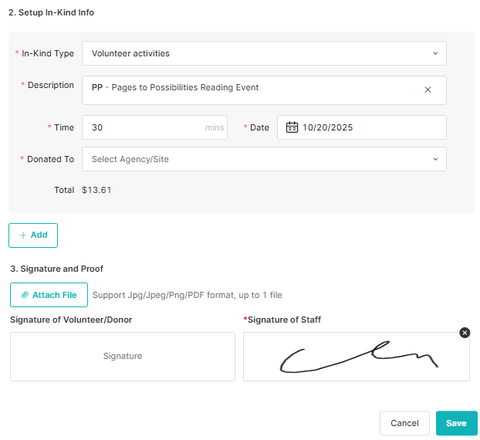
Adding Pages to Possibilities Volunteer Time
13. Upload signed document (required if the volunteer is unable to sign) or
14. Have Volunteer Sign, Staff Sign, and Save.
13
14

Slide 12
Adding Pages to Possibilities Volunteer Time
Option:
Copy and send the URL for the volunteer to enter their own time.
Caution:
It may never be entered, entered timely, or entered correctly, so you need to watch the result.

Slide 13
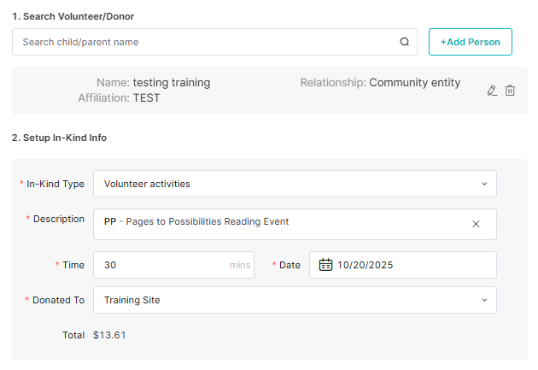
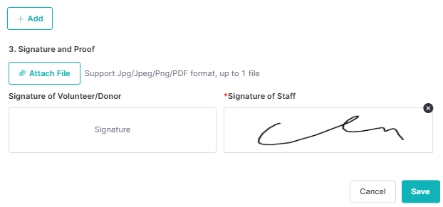
Adding Pages to
Possibilities
Volunteer Time
Your turn to try entries
Follow the steps and select the “Training” site.

Slide 14


Adding Pages to Possibilities Volunteer Time
Completed

Slide 15
